Slide 1
Research Methods Data Analytics

Slide 2
Common Research Methods
Archival
Experiment
Survey
Interview
Case Study
Focus Group
Content Analysis

Slide 3
Archival Research Method
Philosophy
Pragmatism ( Objectivism and Constructivism)
Approach
Predominantly Deductive
Hypothesis determines data collection
Strategies
Secondary Data - Public Archives, Public Data Sets, Social Media
Choices
Qualitative and/or Quantitative
Mono and Mixed Methods
Time Horizons
Longitudinal
Cross Sectional
Procedures
Methods: Correlation, Classification, Prediction
Analysis: Statistical Analysis, Content Analysis
Tools : Machine Learning – Classification, Regression Analysis

Slide 4
Experiment Research Method
Philosophy
Positivism – Can be tested and replicated
Approach
Deductive – Generates hypothesis to define tests
Strategies
Experiment – rigid structure, replicable research
Test causation effect on group compared to control group
Choices
Mono Method: Quantitative
Emphasis on quantifiable results
Time Horizons
Longitudinal – Concentrated samples over longer periods
Procedures
Methods: Descriptive Statistics, Comparative, Correlational
Analysis: Statistical
Tools:
Machine Learning – Classification, Regression
Programming – Python, R

Slide 5
Survey Research Method
Philosophy
Positivism – Testable hypotheses, replicable method
Approach
Deductive - Starts with hypothesis
Strategies
Survey sample group representative of population
Highly economical method of data collection
Choices
Mono Method – Quantitative
Quantifiable Data, Descriptive Research
Time Horizons
Cross Sectional - Point in time study
Procedures
Methods: Online Questionnaires
Analysis: Statistical Analysis
Tools
Online survey services
Business Intelligence Tools
Programming - R, Python

Slide 6
Research Questions
​Can hate speech classification be improved using sentiment analysis?
Which is the most accurate face recognition algorithm available in OpenCV library?
Can consumer smartwatches generate accurate clinical data?
How Feasible is Introduction of 5G Technology in Irish Airports for Data Analytics?
Do different ethical approaches produce similarly stable machine learning algorithms
How could we know if the internet resources in TUD are used primarily for academic purposes?
Do Bees continuously monitor their external temperature?

Slide 7
Can hate speech classification be improved using sentiment analysis?

Slide 8
The Purpose of the Research
Hate speech classification in social media using emotional analysis
Reliable automated solutions for detecting hate speech lacking.
Dictionary based solutions tend to have low precision rates.
Analysis performed to determine if emotional sentiment and lexical analysis combined can improve precision.
Classify content as Hate Speech, Offensive Language or Neutral.
Average precision of 80.64% using SVM. Potential to improve via tuning and expanding emotional models and hate lexicon.

Slide 9
Research Methodology
Philosophy
Constructivism
Approach
Deductive
Investigates improvements to classification using emotional information to confirm theory.
Strategy
Archival Research
Classified Social Media dataset from previous research study
Choices
Mixed Method - Qualitative and Quantitative
Text content, sentiment analysis and lexical analysis
Time Horizons
Cross Sectional – Data comprises tweets from multiple users from various times
Procedures
Methods: Classification, National Language Processing
Lexical and Sentiment Analysis
Machine Learning classification models used to detect hate speech - SVM, Naïve Bayes, Random Forest Trees.

Slide 10
Which is the most accurate face recognition algorithm available in OpenCV library?

Slide 11
The Purpose of the Research
Computer Vision Library (OpenCV)
Implemented Face Recognition Algorithms:
- Local Binary Pattern (LBP)
- Fisherface
- Eigenface
Which one to pick and when?

Slide 12
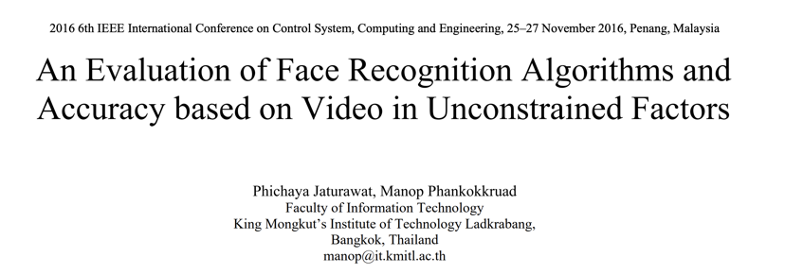

Slide 13
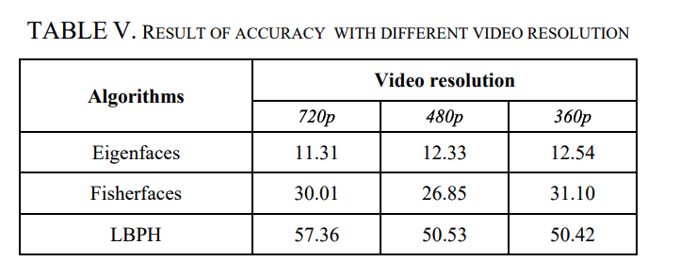
Research Methodology
Basic Research: fills in the knowledge we don’t have. Which algorithm to use, which performs the best, under what circumstances?
Inductive Research: beginning with collecting data to answer the research question – which algorithm is the most accurate?
Quantitative Research - collected data will be expressed in numbers and graphs (table 5)
Research Method: Experimental Research

Slide 14
Can consumer smartwatches generate accurate clinical data?
John McDonnell
D19126351

Slide 15
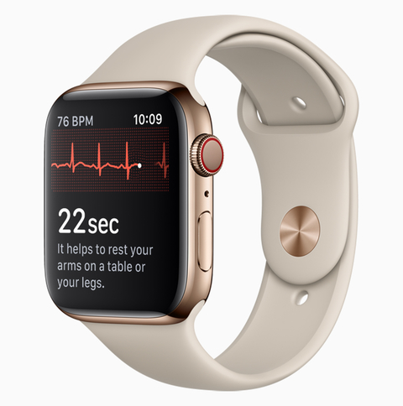
The Purpose of the Research
Large-Scale Assessment of a Smartwatch to Identify Atrial Fibrillation (study by Apple & Stanford University)
Atrial Fibrillation is an irregular heartbeat, can affect up to 1 in 3 people (in the US), and is associated with a quintupling the risk of stroke.
Detected arrhythmias were assessed and eligible participants were mailed an ECG patch to wear for up to 7 days.
Participants with serious arrhythmias were contacted immediately and directed to seek urgent medical care.
All enrolled participants were directed to a web-based end-of-study survey.

Slide 16
The Research Methodology
Methodology | Reasoning
- Quantitative Research - Qualitative Research - Applied Research | We are dealing with observations generated by the Apple Watch recorded as quantities. Survey generated qualitative data. Designed to solve a practical problem.
L1: Philosophy: - Positivism (from Epistemology) - Objectivism (from Ontology) | The emphasis is on quantifiable results that lend themselves to statistical analysis. This is a closed world. Social phenomena and their meanings exist separately to social actors.
L2: Deductive Approach | We are setting out to assess whether a smart watch can identify Atrial Fibrillation. We start with a theory (hypotheses) and move towards observations.
L3: Research Strategies: - Experiment - Survey | The results of the experiment are examined against the expected results. Is more rigid in its structure and process to enable the research to be replicated. End-of-study survey collects additional quantitative as well as qualitative data .
L4: Choices Mixed Method | Both Quantitative data (data generated in study for AF detection) and Qualitative (survey at beginning and end of study).
L5: Time Horizons Cross-sectional | Short term study (median of 117 days). Single point in time.
L6: Techniques and Tools: - Survey - Statistical Analysis - Observational study | Survey using smartphone app. Statistical techniques used to aggregate and analyse results at a predefined confidence level (90%). Observational Survey: sensors on smart watch.

Slide 17
Conclusions and Further Research
Provides a foundation for outcomes or adherence to be reliably assessed with user-owned consumer wearable devices.
Gap: Data is based on US participants only and may be skewed towards the health, lifestyle and demographics of people in that country.
Gap: 25% of participants that received irregular pulse notification had to be excluded because of previous a-fib and/or were already on medication for the condition. Better control for initial study eligibility survey.
Gap: Sample was skewed towards a younger demographic since they were more likely to own a smartwatch.

Slide 18
How Feasible is Introduction of 5G Technology in Irish Airports for Data Analytics?

Slide 19
The Purpose of the Research
The airport – an open but chaotic place. People want to get from A to B as seamlessly as possible – the reality is far from this. Can data analytics improve this?
5G technology is being rolled out to the public – but comes with its limitations along with its advantages. How suitable is this for this project?
Define the challenges/risks involved in such large-scale data gathering.
Define the benefits of implementing this technology to improve smooth flow of passengers and improve the airport’s business.
Define possible ethical alternative methods or technology to 5G technology.

Slide 20
Research Methodology
Formation of the questions to be investigated for primary research through analyzing previously conducted research in similar areas of study.
Conducting the surveys, interviews and pilot experiment and critically analyzing the results with previously conducted primary research and their analysis.
Stating any interesting findings of the primary research and stating any similarities/dissimilarities with previous researches.
Making recommendations based on the benefits and challenges.

Slide 21
Research Methods
Secondary Research – Published Journals, Thesis, Related Literature (books, information booklets)
Primary Research – Public surveys(quantitative data), Interviews(qualitative data), Potential testing of the technology (experimental and quantitative data).

Slide 22
Do different ethical approaches produce similarly stable machine learning algorithms

Slide 23

The Purpose of the Research
Ethical artificial intelligence Is a primary requirement for increased confidence and trust between human and machine
Most of the current research on ethical approaches for autonomous systems focus on applying the ethical principle of preventing harm
Integrating consistent and reliable ethical principles into Artificial Intelligence reasoning bridges a major gap and allows autonomous machines to mimic human behaviour and decision making
[2]

Slide 24
Background
Hypothesis
The mean number of ethical outcomes from a Machine Learning (ML) model does not differ based on the applied ethical agent
Focus on three main approaches to ethics [1]
Deontology
Consequentialism
Virtue ethics
In this context “stable” is defined as consistently producing a predictable outcome

Slide 25
Methodology
Create several instances of a ML model and separate into 3 groups
Train each instance on a specified ethical agent
Generate a series of scenarios with a clearly defined ethical outcome
Apply scenarios to ML models
Assess results
Considerations
Morally neutral
Exceptions
Designer bias

Slide 26
Method
Quantitatve data – Models will be scored based on outcome
Applied research – Looking for a relationship (Experimental)
Descriptive research – Comparative
Research onion
Philosophy – Ontology(Constructivism)
Approach – Deductive
Strategy – Experimental
Choices - Mixed methods

Slide 27
How could we know if the internet resources in TUD are used primarily for academic purposes?

Slide 28
The Purpose of the Research
Internet is very important to the academic success
The usage of it can be for both academic and non-academic purposes
This research will be done by recording the daily internet bandwidth usage for the university
Data collected will be both for upload and download traffic (in and out) using flows.
Data is be further analyzed into which traffic is ‘good’ vs traffic that is ‘bad’
Classification of the data will be done using machine learning techniques
The traffic monitoring and analysis will not capture individual details and therefore the study is ethical

Slide 29
The Research Methodology
Methodology | Reasoning
- Quantitative Research - Qualitative Research - Applied Research | Measuring the capacity usage for each flow which is numeric data. Narrative of the data flows with the packet signatures to understand what type of traffic it. Trying to solve the problem of students not using the internet well enough for academic purposes
L1: Philosophy: - Objectivism (from Ontology) - Interpretivism (from Epistemology) | Social phenomena (Internet usage) and the actors (students) exits separately Analysing students' usage of the internet with respect to their academics.
L2: Deductive Approach | It is believed that we can identify the traffic that is making good use of the internet.
L3: Research Strategies: - Case study | We are basing the research focus on just one school - TUD
L4: Choices Mixed Method | Both Quantitative data (bandwidth usage) and Qualitative (flow of the data).
L5: Time Horizons Longitudinal | Study can take about 1-3 months.
L6: Techniques and Tools: - Observational - Statistical Analysis - | Traffic capture on the internet routers Machine learning approach to classify the data using either python, R or SAS

Slide 30
Do Bees continuously monitor their external temperature?
Kalpana Konety
D19124997

Slide 31
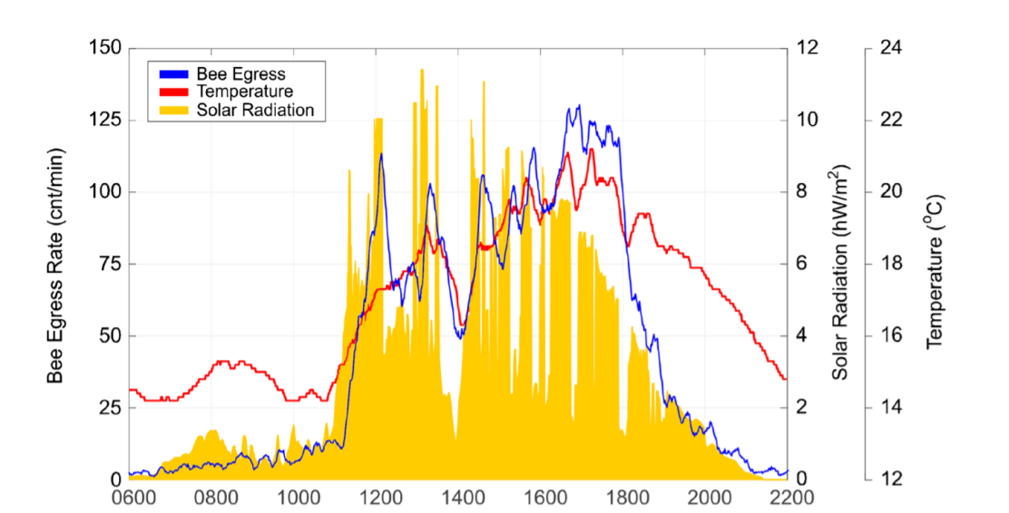
The Purpose of the Research
Predictive modelling of honeybee foraging activity using local weather conditions (University of Bristol, UK)
Save the Bees.
Identify meteorological conditions that endanger bee colonies.
To continuous, remote monitoring of honeybee colonies with possible implications for early detection and prevention of hive abandonment disorders (a possible warning system for beekeepers).
Help to determine if anomalously large errors in prediction correlate to pesticides presence.
Figure: Example day of data (7 June 2014) showing bee egress rate (blue), temperature (red) and solar radiation (orange, filled). This day began with cloud cover until shortly after 11 am. Immediately after the clouds cleared, indicated by an increase in solar radiation then temperature, the bees begin to leave the hive at an increased rate.

Slide 32
The Research Methodology
Methodology | Reasoning
Quantitative Research Applied Research Analytical Research | Measured quantifiable data like bee egress rate, temperature, solar radiation, rain and humidity etc. Conducted Spearman rank/person method to calculate correlation between temperature and bee ER and solar radiation and bee ER. To solve a practical problem of bee population decline. Attempts to explain how/why bee foraging changes with meteorological conditions.
L1: Philosophy: Positivism (from Epistemology) Objectivism (from Ontology) | Predictive model created can be replicated by other researchers to generate the same results. Social phenomena like temperature, rain exist separately to social actors
L2: Approaches: Deductive Approach | Started with a question, and research provided with an answer.
L3: Research Strategies: Experiment Action research Grounded Theory | The results of the experiment are examined against the expected results. Is more rigid in its structure and process to enable the research to be replicated. Have a clear objective. Problem-solving approach to a specific research problem Prediction being generated

Slide 33
The Research Methodology
Methodology | Reasoning
L4: Choices Mono-Method | Quantitative data measured for experiment include bee egress rate along with temperature, solar radiation, atmospheric pressure, humidity, rainfall, wind direction and speed.
L5: Time Horizons Cross-sectional | Short term study (42 days between June-Sep in 2013, 74 days between July-Sep in 2014).
L6: Techniques and Tools: Data collection Analysis | Experimental output (numeric-data), collected from two different hives. Statistical analysis of numeric data. Correlation between temperature and Bee forage, solar radiation and bee forage. Predictive analysis using linear regression model.

Slide 34
Conclusions and Further Research
Bee foraging effort, measured as the number of bees that leave the hive on foraging flights in each minute, is tightly coupled to the coincident meteorological conditions near the hive.
Most important conditions temperature and solar radiation.
The reaction period between changes in weather conditions and changes in bee foraging activity is less than 1 min. These results suggest that bees continuously monitor their external environment and use the informational gained to make decisions about whether to embark on foraging journeys.
This knowledge could lead to better informed conservation efforts of domesticated and wild bees in general and improved colony management by commercial bee keepers.
Gap: Experiments are conducted only during months from June and Sep.
So, rest of the year conditions are not known.

Slide 35
References
Gomes, Marco & Novais, Paulo & Henriques, Pedro. (2018). Hate Speech Classification in Social Media Using Emotional Analysis. 61-66. 10.1109/BRACIS.2018.00019.
Jaturawat, P., & Phankokkruad, M. (2016). An evaluation of face recognition algorithms and accuracy based on video in unconstrained factors. 2016 6th IEEE International Conference on Control System, Computing and Engineering (ICCSCE). doi: 10.1109/iccsce.2016.7893578
Perez, M. V., Mahaffey, K. W., Hedlin, H., Rumsfeld, J. S., Garcia, A., Ferris, T., … Turakhia, M. P. (2019). Large-Scale Assessment of a Smartwatch to Identify Atrial Fibrillation. New England Journal of Medicine, 381(20), 1909–1917. doi: 10.1056/nejmoa1901183
N. Le, Y. Zheng, Q. Huang and Y. Pei, "Prospect of 5G Application in Civil Airport," 2019 IEEE 1st International Conference on Civil Aviation Safety and Information Technology (ICCASIT), Kunming, China, 2019, pp. 591-595.
P. Popovski, K. F. Trillingsgaard, O. Simeone et al., "5G Wireless Network Slicing for eMBB URLLC and mMTC: A Communication-Theoretic View", IEEE Access, pp. 1-1, 2018.
[1]Bench-Capon, T. J. M. ‘Ethical Approaches and Autonomous Systems’. Artificial Intelligence 281 (1 April 2020): 103239. https://doi.org/10.1016/j.artint.2020.103239.
Adekitan, A. I., Abolade, J., & Shobayo, O. (2019). Data mining approach for predicting the daily Internet data traffic of a smart university. Journal of Big Data, 6(1). doi: 10.1186/s40537-019-0176-5
Yuan, R., Li, Z., Guan, X., & Xu, L. (2008). An SVM-based machine learning method for accurate internet traffic classification. Information Systems Frontiers, 12(2), 149–156. doi: 10.1007/s10796-008-9131-2
Clarke, Dominic & Robert, Daniel. (2018). Predictive modelling of honey bee foraging activity using local weather conditions. Apidologie. 49. 10.1007/s13592-018-0565-3.
[2]Frankish, K., & Ramsey, W. M. (2014). The Cambridge Handbook of Artificial Intelligence. Cambridge University Press.

